Slide 1
UNIT -2
INTERPROCESS COMMUNICATION
(Chapter – 4)
George Coulouris
4th Edition

Slide 2
Topics to cover…..
Introduction
API for Internet Protocols
External Data Representation and Marshalling
Client Server Communication
Group Communication

Slide 3
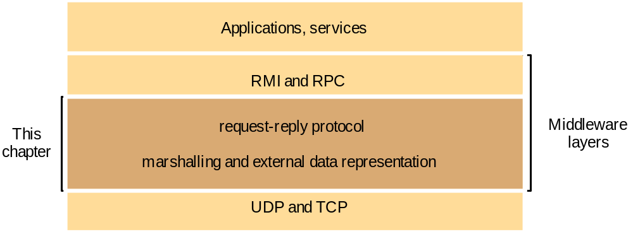
Introduction:
Interprocess communication is concerned with middleware.

Slide 4
Remote Method Invocation: Remote method invocation allows an object to invoke a method in an object in a remote process.
Remote Procedure Call : A remote procedure call allows a client to call a procedure in a remote server.

Slide 5
API for Internet Protocols
Characteristic of Interprocess communication:
Msg passing between pair of processes – supported by 2 msg communication operations: Send and Receive.
A. Synchronous and Asynchronous Communication
B. Message Destination
C. Reliability
D. Ordering

Slide 6
A) Synchronous and Asynchronous communication:
Sending process cause msgs to be added to remote queues and receiving process remove msg’s from local queues.
Communication b/w sending and receiving be either synchronous or asynchronous.
In synchronous form of communication sending and receiving processes synchronize at every msg.
In this both sending and receiving are blocking operations.
Whenever send is issued , the sending process is blocked until the corresponding receive is issued.
Whenever receive is issued , the process blocks until a msg arrives.

Slide 7
In asynchronous, it is non blocking.
Send process is allowed to proceed as soon as the msg has been copied to local buffer.
The receive operation have blocking and nonblocking variants.
In nonblocking, receiving process proceeds with its program after issuing receive operation, which provides buffer to be filled.
But when buffer has been filled it receive notification by interrupt.

Slide 8
B) Message Destination:
Messages are sent to ( Internet address, local port) pairs.(socket address)
Local port is msg destination.
Port have exactly one receiver, have many sender.
Processes use multiple ports from which to receive msg’s.
Any client process knows the number of a port can send msg to it. Servers publish their port number.(well known port number )

Slide 9
What is location transparency ?
In a distributed system it is the idea that the resources accessed by a user can be anywhere on the network without the user having any idea where the resource is located.
A file could be on the user's own PC, or thousands of miles away on another server

Slide 10
In LT client prgs refer to service by name and use a name server or binder to translate their names into server locations at run time.
This allows services to be relocated but not to migrate.
Users of a distributed system should not have to be aware of where a resource is physically located.

Slide 11
What is Name Server?
A name server translates domain names into IP addresses. This makes it possible for a user to access a website by typing in the domain name instead of the website's actual IP address. For example, when you type in "www.microsoft.com," the request gets sent to Microsoft's name server which returns the IP address of the Microsoft website.

Slide 12
C) Reliability: It defines reliable communication in terms of validity and integrity.
For validity , a point – point msg service is said to be reliable , if msg’s are guaranteed to be delivered despite a reasonable number of packets being dropped or lost.
A point- point msg service is said to be unreliable if msg’s are not guaranteed to be delivered.
For integrity , messages must arrive uncorrupted and without duplication.
.

Slide 13
D) Ordering:
Some applications require that msgs be delivered in sender order- order in which transmitted by sender. Otherwise it is considered as failure

Slide 14
Sockets: Both UDP and TCP which provides end point for communication b/w processes.
agreed port
any port
socket
socket
message
client
server
other ports
Internet address = 138.37.94.248
Internet address = 138.37.88.249

Slide 15
Interprocess communication consist of transmitting a msg b/w a socket in one process and socket in another process.
For process to receive msg, its socket must bound to local port and one of internet address of computer on which it runs ie. associates port no. with socket.
Msgs sent to a particular internet address and portno. can be received only by a process whose socket is associated with that internet address and port number.

Slide 16
Two kinds of communication:
* UDP communication
* TCP communication
SOCK_STREAM
  reliable delivery
  in-order guaranteed
  connection-oriented
  Bidirectional
  Eg. TCP
SOCK_DGRAM
  unreliable delivery
  no order guarantees
  connectionless
  can send or receive
  Eg. UDP

Slide 17
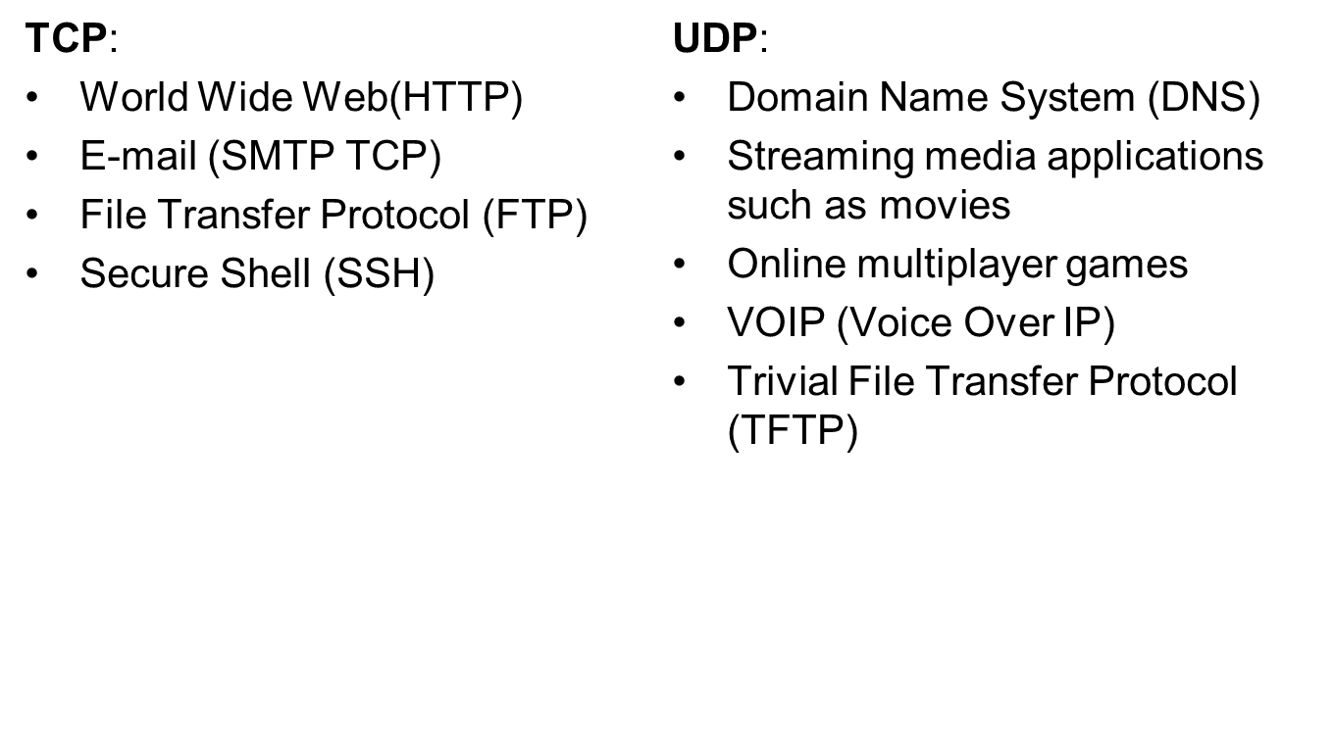
TCP / UDP Examples

Slide 18
Review: UDP Client-Server
Interaction
UDP Server
socket()
bind()
UDP Client
recvfrom()
socket()
blocks until datagram
received from a client
sendto()
data request
data reply
sendto()
recvfrom()
close()
from UNIX Network Programming Volume 1, figure 8.1
Lecture 3: 9-4-01

Slide 19
Review: TCP Client-Server Interaction
TCP Server
socket()
bind()
TCP Client
listen()
socket()
accept()
connection establishment
connect()
data request
read()
write()
data reply
write()
read()
close()
end-of-file notification
read()
close()
from UNIX Network Programming Volume 1, figure 4.1
Lecture 3: 9-4-01

Slide 20
UDP Datagram Communication:
A datagram sent by UDP without acknowledge or retries.
To send or receive msg, a process must create socket bound to an internet address and local port. A server will bind its socket to a server port – one that it makes known to client so they can send msg’s.
Msg size: The receiving process needs to specify an array of bytes of a particular size in which to receive a msg. IP protocol allows packet length of upto 2¹⁶ bytes.

Slide 21
Blocking:
Sockets normally provide non blocking sends and blocking receives.
Send operation returns, when it is handed the msg to UDP or IP protocols which are responsible for transmitting to its destination.
Msg is placed in queue for the socket that is bound to destination port.
The msg can be collected by invocation or receive on that socket.

Slide 22
Timeouts:
The process that have used a receive operation should wait indefinitely where sending process has crashed or been lost. To allow such requirements , timeouts can be set on sockets.

Slide 23
Receive from any:
Receive method does not specify an origin for msgs.
Invocation of receive gets a msg addressed to its socket from any origin.

Slide 24
Failure Model:
Omission Failure: Msg can be dropped b’cos of checksum error or no buffer space.
Ordering: Msg can be delivered out of sender order.
Use of UDP:
UDP datagrams do not suffer from the overheads associated with guaranteed msg delivery.

Slide 25
UDP and TCP
In general, differences in how UDP and TCP deliver data are similar to the differences between a telephone call and a postcard.
TCP works like a telephone call by verifying that the destination is available and ready to communicate.
UDP works like a postcard--messages are small and delivery is likely, but not always assured.
UDP is typically used by programs that transmit small amounts of data at one time or have real-time requirements.
So , the low overhead and multicasting capabilities of UDP are better suited than TCP

Slide 26
TCP Stream Communication:
Msg Sizes: The application choose how much data it writes to a stream or reads from it. TCP stream decides how much data to collect before transmitting it as one or more IP packets. The data is handed to the application as requested.
Lost Msgs: It uses ack scheme. Sending end keeps a record of each IP packet sent and receiving end acknowledges all. If sender does not receive an ack within a timeout, it retransmits the msg.
Flow Control: If the sender is too fast, then it is blocked until the receiver consumed sufficient data.
Msg duplication and ordering: Msg identifiers associated with each packet, which enables recipient to detect and reject duplicates or to reorder msg’s.

Slide 27
Msg Destination: They establish a connection before they communicate over a stream. Once connection is established, the processes simply read from and write to the stream without needing to use Internet addresses and ports.
Matching Data items: Two communicating processes agree to the content of data transmitted. If one process writes an int followed by double , then the reader at the other end must read an int followed by a double. If they do not cooperate , it results in error or may block due to insufficient data in the stream

Slide 28
Blocking: The data written is kept in a queue in destination socket. The receiver gets data from queue or it will block until data becomes available.
Threads: When server accepts a connection , it creates a new thread in which to communicate with new client. The advantage is ,the server can block , waiting for input without delaying other clients.

Slide 29
Failure Model:
Reliability: TCP use checksums to detect and reject corrupt packets and sequence number to detect and reject duplicate packets.
N/w connecting a pair of communicating processes is severely congested, TCP will receive no acknowledgements and after sometime it will declare that connection to be broken.

Slide 30
When connection is broken , the process is notified when it attempts to read or write.This has following effects:
It cannot distinguish whether it is a n/w failure or process failure.
The communicating processes cannot tell whether the msgs they sent recently have been received or not.

Slide 31
Validity: TCP uses timeouts and retransmission to deal with lost packets. TCP is not reliable in broken communication ie. if the connection is broken, it will be notified during read or write.The processes using the connection cannot distinguish b/w network failure and failure of the process

Slide 32
Uses of TCP:
HTTP : is used for communication b/w web browsers and web servers.
FTP: It allows directories on a remote computer to be browsed and files to be trasferred from one computer to another over a connection.
Telnet: It provides access by means of a terminal sessions to a remote computer.
SMTP: It is used to send mail b/w computers.

Slide 33
External Data Representation and marshalling:
Irrespective of communication used, data structures must be flattened ie. converting to sequence of bytes before transmission and rebuilt on arrival.
Methods to enable any two computers to exchange values:
The values are converted to external format before transmission and converted to local form on receipt. If 2 computers are known to be of same type, conversion to external format can be ommited.
The values are transmitted in senders format and recipients converts if necessary.
“ An agreed representation of data structures and primitive values are called External Data Representation.”

Slide 34
Marshalling: It is the process of taking a collection of data items and assembling them into a form suitable for transmission in a msg.
Unmarshalling: It is the process of diassembling them on arrival to produce equivalent collection of data items at the destination.
Marshalling and unmarshalling are carried out by middleware layer without any involvement on the part of application programmer.

Slide 35
Two alternative approaches to EDR and marshalling are
1. CORBA’s common data representation
2. Java’s object serialization

Slide 36
1. CORBA’s common data representation
Primitive types:
This consist of 15 primitive types which includes short(16 bit), long(32 bit), unsigned short, long and float(32 bit), double (64 bit), char , Boolean(TRUE, FALSE) etc.

Slide 37
CDR defines a representation for both big endian and little endian orderings.
a) Big Endian and Little Endian describe the order or sequence in which multi – byte is stored in memory.
b) Little Endian specifies that the least significant byte is stored in the lowest memory address.
c) Big Endian formatting takes the most significant byte and stores it in the lowest memory address

Slide 38
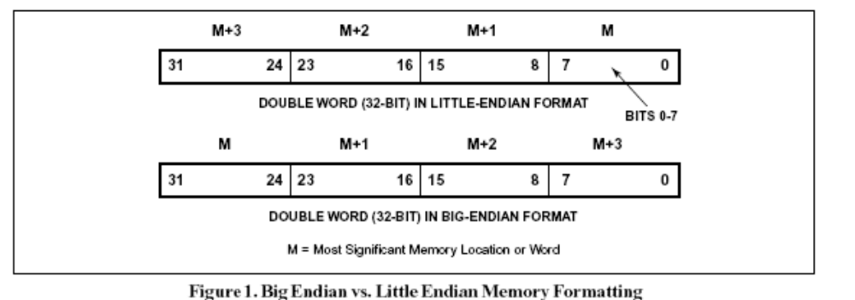
Values are transmitted in sender’s ordering and the recipient translates if it requires different ordering. Eg. 16 bit short occupies 2 bytes and for big endian ordering the most significant bits occupy first byte and least significant bits occupy the second byte.

Slide 39
CORBA CDR for constructed type:
T
y
p
e
Re
pr
e
s
e
n
ta
t
i
o
n
s
e
q
ue
n
ce
l
e
n
g
th
(
u
n
si
g
n
ed
l
o
n
g
)
fo
ll
ow
ed
b
y
el
e
m
e
nt
s
i
n
o
r
d
e
r
s
t
ri
n
g
l
e
n
g
th
(
u
n
si
g
n
ed
l
o
n
g
)
fo
ll
ow
ed
b
y
ch
a
ra
c
te
rs
i
n o
r
d
e
r
(
ca
n
al
so
ca
n
h
av
e
w
i
de
ch
a
ra
c
te
rs)
a
r
ra
y
a
rr
ay
e
le
m
e
n
t
s i
n
o
r
de
r (
n
o l
en
g
t
h s
p
e
ci
f
ie
d b
eca
us
e
i
t
is
f
i
x
e
d
)
s
t
ru
ct
i
n t
he
or
de
r o
f
de
c
la
r
at
i
o
n o
f
t
he
co
mp
o
n
e
n
t
s
e
n
u
m
e
r
a
t
e
d
u
n
s
i
g
n
e
d
l
o
n
g
(
t
h
e
v
a
l
ue
s a
re
s
pe
c
i
f
ie
d
b
y t
he
o
r
de
r d
ec
l
ar
e
d
)
u
ni
o
n
t
y
p
e
ta
g f
o
l
l
o
we
d b
y
t
h
e s
el
e
cte
d m
e
mb
er

Slide 40
CORBA CDR message:
Struct Person{
string name;
string place;
long year;
};

Slide 41
index in
notes
sequence of bytes
4 bytes
on representation
0–3
5
length of string
4–7
"Smit"
‘Smith’
8–11
"h___"
12–15
6
length of string
16–19
"Lond"
‘London’
20-23
"on__"
24–27
1934
unsigned long
The flattened form represents a
Person
struct with value: {‘Smith’, ‘London’, 1934}

Slide 42
Java’s object serialization :
In java RMI both data and primitive data values may be passed as arguments and results of method invocations.
Serialization: The term serialization refers to the activity of flattening an object or a connected set of objects into a serial form, that is suitable for storing on disk or transmitting in a message.
Deserialization: It consist of restoring the state of an object or a set of objects from their serialized form. Some information about the class of each object is included in the serialized form. This information enables the recipient to load the appropriate class when an object is deserialized.

Slide 43
Java object serialization
public class Person implements Serializable {
private String name;
private String place;
private int year;
public Person(String aName, String aPlace, int aYear) {
name = aName;
place = aPlace;
year = aYear;
}
// followed by methods for accessing the instance variables
}

Slide 44
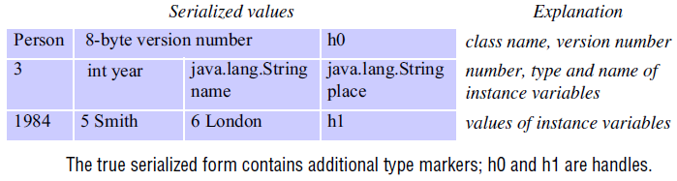
Indication of Java serialized form
consider the serialization of the following object:
Person p = new Person("Smith", "London", 1984);

Slide 45
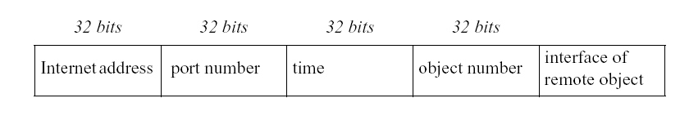
Remote Object Reference:
When client invokes a method in remote object, invocation msg is sent to server process that hosts the remote object. This msg need to specify which particular objects is to have its method invoked.
A remote object reference is an identifier for remote object that is valid throughout a distributed system.
A remote object reference is passed in the invocation message to specify which object is to be invoked.
4. Remote object references must be generated in a manner that ensures uniqueness over space and time.

Slide 46
There may be many processes hosting remote objects, so remote object references must be unique among all of the processes in the various computers in a DS.
6. After the remote object associated with a given remote object reference is deleted, it is important that remote object reference is not reused. 7. Any attempt to invoke a deleted object should produce an error rather than allow access to a different object.
One way to ensure remote object method is unique, is by concatenating the Internet address of its computer and port number that created it with the time of its creation and local object number.
Local object number is incremented each time an object is created in that process.
Port Number and time produces a unique process identifier on that computer.

Slide 47
RMI Invocation:
RMI Client: It is an object that invokes remote methods on an RMI Server.
Stub: A stub is proxy that stands for RMI Server on client side and handles remote method invocation on behalf of RMI Client.
Skeleton: It is a proxy that stands for RMI client on server side and handles remote method invocation on RMI Server on behalf of client.
Registry Service: A Registry Service is an application that provides the facility of registration & lookup of Remote stub.

Slide 48
Extra notes for reference…….
For an RMI client to contact a remote RMI server, the client must first hold a reference to the server (this is where RMI registry is coming into picture, to give you reference to the RMI server). The Naming.lookup method call is the most common mechanism by which clients initially obtain references to remote servers.
Every remote reference contains a server hostname and port number that allow clients to locate the server that is serving a particular remote object (this is where RMI server is coming into picture). Once a RMI client has a remote reference, the client will use the hostname and port provided in the reference to open a socket connection to the remote server.
A registry is a remote object that maps names to remote objects. A server registers its remote objects with the registry so that they can be looked up. When an object wants to invoke a method on a remote object, it must first lookup the remote object using its name. The registry returns to the calling object a reference to the remote object, using which a remote method can be invoked.

Slide 49
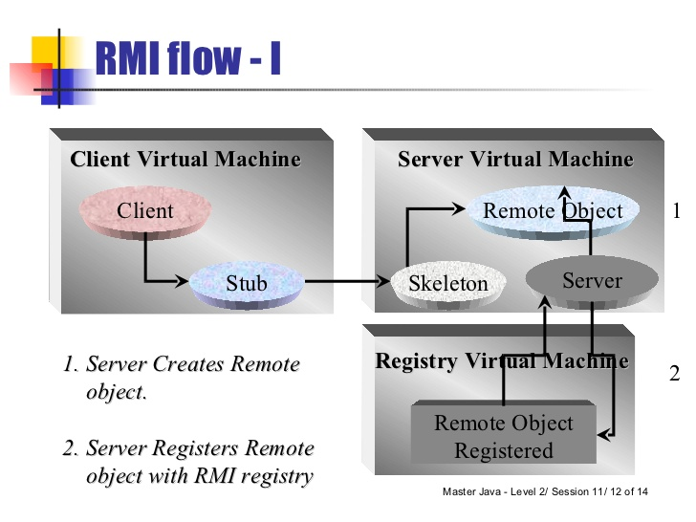
Extra notes for reference…….

Slide 50
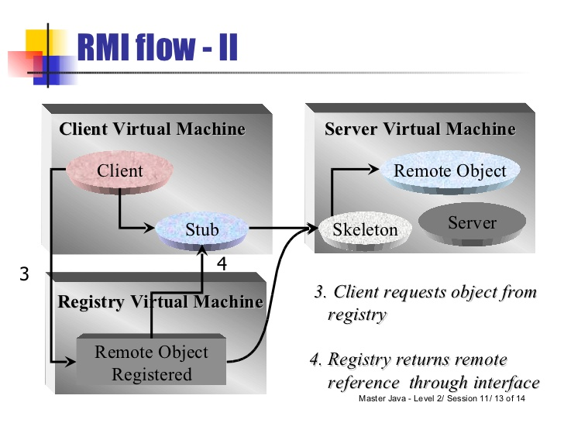
Extra notes for reference…….

Slide 51
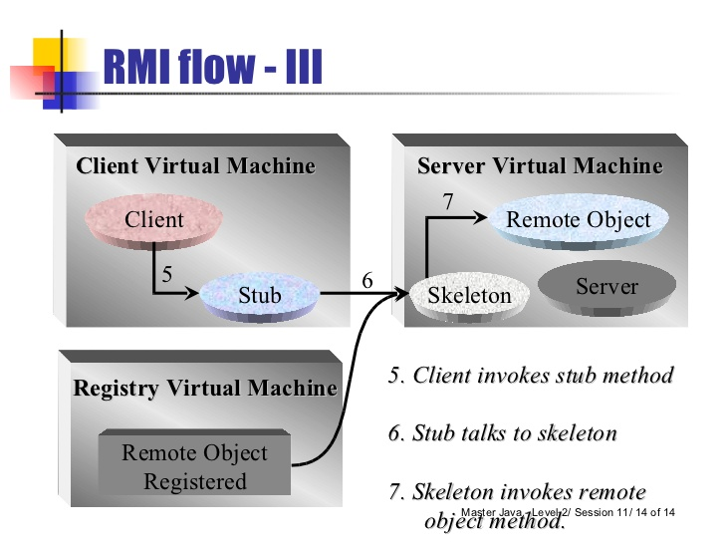
Extra notes for reference…….

Slide 52
Client Server Communication
The request – reply protocol
Message Identifiers
Failure Model of request – reply protocol
Timeouts
Discarding duplicate request messages
Lost reply messages
History
RPC exchange protocols

Slide 53
Client Server Communication:
In normal case request reply communication is synchronous b’cos client process blocks until the reply arrives from the server. It is an effective acknowledgement to the client.
Asynchronous request – reply communication is an alternative, where clients can afford to retrieve replies later.

Slide 54
Overhead associated with TCP stream:
Acknowledgements are redundant
Establishing a connection involves 2 extra pairs of msgs in addition to the pair required for a request and reply.
Flow control is redundant for the majority of invocations which pass only small arguments and results. (Flow control is controlled by the receiving side. It ensures that the sender only sends what the receiver can handle.)

Slide 55
Request Reply Protocol:
Do Operation
public byte[] doOperation (RemoteObjectRef o, int methodId, byte[] arguments)
get request
public byte[] getRequest ();
send reply
public void sendReply (byte[] reply, InetAddress clientHost, int clientPort);
Note: RMI and RPC are supported by Request- Reply protocol

Slide 56
Request – Reply Communication
doOperation
Request
message
getRequest
select object
(wait)
execute
Reply
method
message
sendReply
(continuation)

Slide 57
Do operation used by clients to invoke remote operation.
Its arguments specify remote object, which method to invoke, together with additional information required by method. Its result is RMI reply.
The client calling doOperation marshals the arguments into an array of bytes and unmarshalls the array of bytes that is returned.
public byte[] doOperation (RemoteObjectRef o, int methodId, byte[] arguments)
sends a request message to the remote object and returns the reply.

Slide 58
The arguments specify the remote object, the method to be invoked and the arguments of that method.
The first argument –references to remote objects
This provides methods for getting internet address and port of the server of the remote object.
The doOperation method sends a request msg to the server whose internet address and port are specified in the remote object reference.
After sending , the doOperation invokes receive to get a reply msg from which it extracts the result and returns it to the caller.

Slide 59
The doOperation is blocked until the server performs the request and reply to the client process
Get request is used by server process to acquire service request. when the server has invoked the method in the specified object, it then uses send reply to send the reply msg to the client.
public byte[] getRequest ();
acquires a client request via the server port.
When the reply msg is received by the client the original doOperation is unblocked and execution of client program continues.
public void sendReply (byte[] reply, InetAddress clientHost, int clientPort);
sends the reply message reply to the client at its Internet address and port.

Slide 60
Request –Reply msg structure:
messageType
int (0=Request, 1= Reply)
requestId
int
objectReference
RemoteObjectRef
methodId
int or Method
arguments
array of bytes

Slide 61
The first field indicates whether the msg is request or a reply msg.
The second field requestId contains a msg identifier.
A doOperation in the client generates a requestID for each request msg and the server copies them into the corresponding reply msgs.
This enables doOperation to check that a reply msg is the result of the current request.
The third field is a remote object reference marshalled in the form
The fourth field is an identifier for the method to be invoked

Slide 62
Msg Identifier:
Each msg have a unique identifier by which it may be referenced.
Msg identifier consist of 2 parts:
request ID – Increasing sequence of integers – by sending process and it makes the identifier unique to the sender
Identifier for sender process.(its port and Internet address) and this makes unique in the DS.

Slide 63
Failure Model of Request –Reply Protocol(Over UDP datagrams)
They suffer from omission failures
Msgs are not guaranteed to be delivered in sender order.
It also suffers crash failure.
Timeouts:
1.After the timeout of doOperation , It returns immediately from doOperation with an indication to a client that doOperation has failed.(not an usual way of approach)
2.Time out may be of several reasons eg. Request might have lost etc.
3. doOperation sends the request msg repeatedly. After finding out the delay is due to lack of response from server, then doOperation indicate the client by an exception.

Slide 64
Discarding duplicate request msgs:
when request msg is retransmitted, the server may receive msgs more than once.
This can lead to server executing an operation more than once for the same request.
Protocol is designed to identify same request identifier and filter out duplicates.

Slide 65
Lost reply msgs:
When the server already sent the reply and when it receives a duplicate request , it has to execute the operation again to obtain the result, unless it had stored the result of the original execution.
An idempotent operation is an operation that can be performed repeatedly with the same effect as it had been performed exactly once.
A server whose operation are all idempotent need not take special measures to avoid executing its operation more than once.

Slide 66
History:
This term is used to refer to a structure that contains the record of reply msgs that have been transmitted.
An entry in a history contains a request identifier, a msg and an identifier of the client to which it was sent.
Its purpose is to allow the server to retransmit reply msgs when client processes request them.
How history is cleared?
server considers the request as the ack of last reply sent. If client terminates, it will not send a request to a client, therefore reply msg’s from history discarded after a period of time.

Slide 67
RPC exchange protocols:
In the presence of communication failures they are used for implementing various types of RPC’s.
The request protocol (R)
The request – reply protocol (RR)
The request – reply – acknowledge reply protocol (RRA)

Slide 68
The R protocol is used when there is no value to be returned from the procedure and the client requires no confirmation that the procedure has been executed.
The RR protocol used for most client server exchanges bcos it is based on request reply protocol. Server reply is regarded as acknowledgement
RRA is based on exchange of 3 msgs. Request – reply – acknowledge reply. The ack. reply msg contains the request id from the reply msg being acknowledged. This will enable the server to discard entries from its history. The arrival of request id in an acknowledgement msg that will be interpreted as acknowledging the receipt of all reply msgs with lower request ids.

Slide 69
Use of TCP streams to implement R-R protocol:
R-R msgs are delivered reliabily
So no need of dealing with retransmission of msgs, filtering of duplicates or histories.
Overhead of TCP ack msgs reduced when reply msg follow soon after a request msg.
Sometimes some application does not require all facilities offered by TCP
Sun NFS uses fixed size file blocks
Its operations are idempotent – it dosen’t matter if operations are executed more than once.

Slide 70
Group Communication:
A communication from one process to a group of other processes is achieved by multicast operation.
This is an operation that sends a single msg from one process to each of the members of a group of processes.

Slide 71

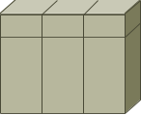
Unicast
Server
Router
Multicast
Server
Router

Slide 72

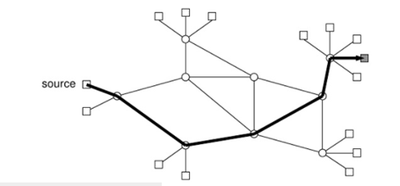
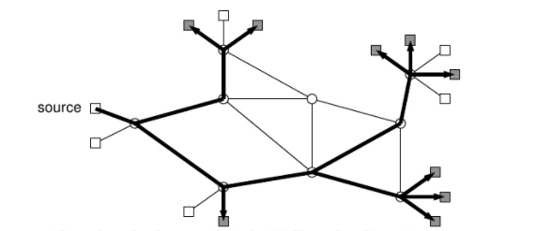
Unicast
Multicast

Slide 73
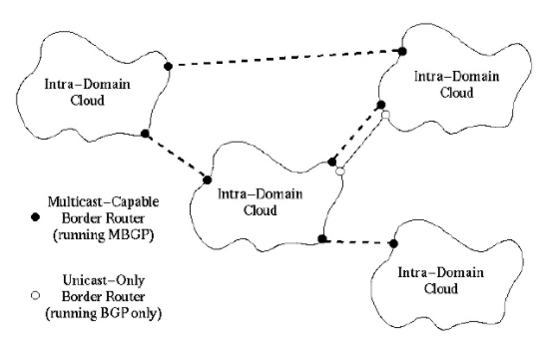
Inter – Domain Multicast

Slide 74
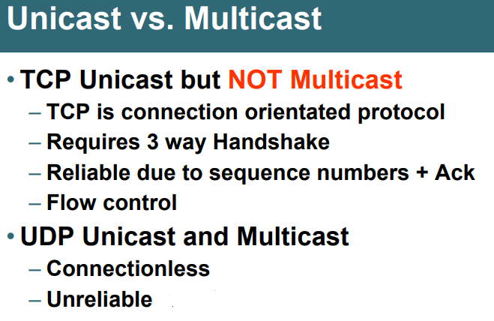

Slide 75
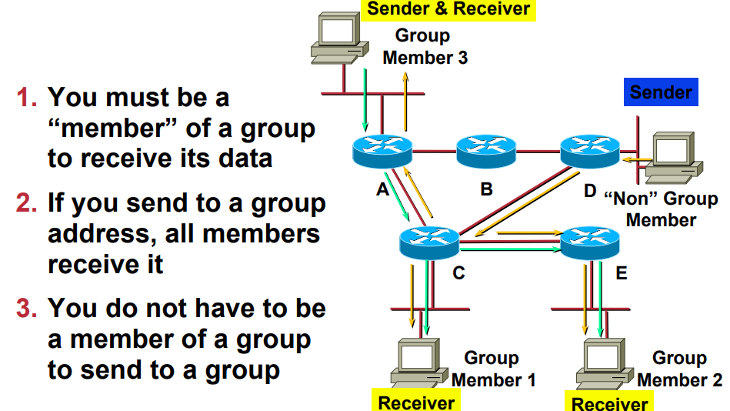

Slide 76
Characteristic of multicast messages:
Fault Tolerance based on replicated services:
It consist of group of servers. Client request are multicast to all the members of the group each performs identical operation. When some of the members fail, client can still be served.
Finding discovery service in spontaneous networking:
Multicast msgs can be used by servers and clients to locate available discovery services in order to register their interfaces or to look up their interfaces of other services in the DS.

Slide 77
Better Performance thru Replicated Data:
Data are replicated to improve the performance of services. Sometimes replica would be maintained in users computer. When data changes, the new value is multicast to the processes managing the replicas.
Propagation of Event Notification:
Multicast to a group may be used to notify processes when something happens. News system might notify interested users when a new msgs has been posted on a particular newsgroup.

Slide 78
IP Multicast – An implementation of Group Communication:
IP multicast is built on top of Internet protocol.
IP muticast allows the sender to transmit a single IP packet to a set of computers that form a multicast group.
The sender is unaware of the identities of the individual recipients and of the size of the group.
A multicast group is specified by a class D internet address. Whose address with first 4 bits are 1110 in IPV4.
The membership of multicast group are dynamic, allowing computers to join or leave.

Slide 79
The following details are specific to IPV4:
Multicast Routers: IP packets can be multicast both on a local network and on the wider internet. Local multicast use the multicast capability of local network. Eg. Ethernet. Those that are multicast in the internet make use of multicast routers which pass to routers on other network with members where they again multicast to local members. The sender can specify the number of routers it is allowed to pass – it is called the time to live.(TTL)

Slide 80
Multicast address allocation: It may be permanent or temporary.
Permanent group exist even when there are no members. Their range is specified as 224.0.0.1 – 224.0.0.225.
The remainder of the multicast addresses are available for use by temporary groups, which must be created before use and cease to exist when all members have left.

Slide 81
Failure Model:
Ommission failure
Msgs are not gauranteed to be delivered to any particular group member even in the face of a single ommission failure.
Msgs are not gauranteed to be delivered called as unreliable multicast. i.e some but not all of the members of the group may receive it.

Slide 82
Reliability and ordering of multicast:
In multicast , to allow a single datagram to arrive at multiple recipients, anyone of those recipients may drop msgs bcos its buffer is full.
Datagrams sent from one multicast router to another may be lost , thus preventing all recipients beyond that router receiving the msg.
If multicast router fails, the group member beyond the router will not receive the multicast msg.
Msgs sent by a process may not arrive in same order at all the members of the group.

Slide 83
Some examples of the effects of reliability and ordering:
Fault Tolerant Based on Replicated Services: A replicated service that consist of the members of a group of servers that start in the same initial time and always perform the same operation in the same order so as to remain consistent. This application of multicast requires that either all or none should receive each request to perform an operation.

Slide 84
Finding the discovery services in spontaneous networking
Better performance thru replicated data
Propagation of event notification.

Slide 85
We need a multicast protocol more reliable than IP protocol
Need reliable multicast – msg transmitted received by all or by none of them
Requirements of ordering – totally ordered multicast- msg transmitted to a group reach all the members in same order.

Slide 86
Extra notes for reference….
An IP multicast group address is used by sources and the receivers to send and receive content. Sources use the group address as the IP destination address in their data packets. Receivers use this group address to inform the network that they are interested in receiving packets sent to that group. For example, if some content is associated with group 239.1.1.1, the source will send data packets destined to 239.1.1.1. Receivers for that content will inform the network that they are interested in receiving data packets sent to the group 239.1.1.1. The receiver "joins" 239.1.1.1.

Slide 87
Extra notes for reference….
In the case of multicasting, the user is simply instructing the computer's network card to listen to a particular IP address for the multicast. The computer originating the multicast does not need to know who has decided to receive it.

